Slide 1

Identifying ‘Body Shaming’ Tweets
Shikshya Adhikari
Springboard Final Capstone

Slide 2
Purpose
Body shaming is a big problem on social media
Celebrities, body positivity models, social media influencers
Identify body shaming tweets – help companies flag such comments

Slide 3
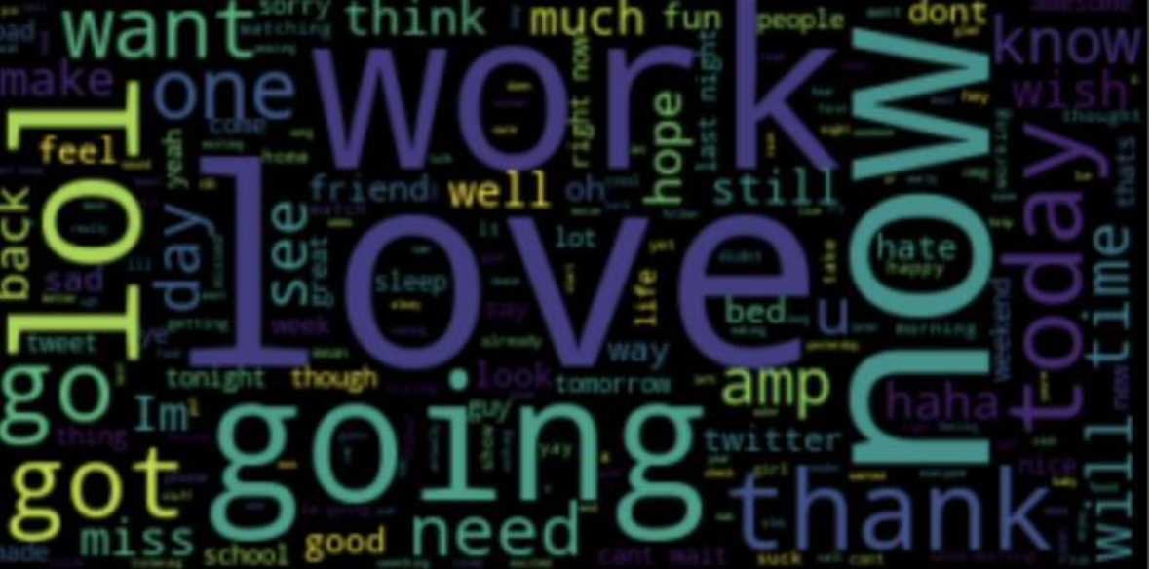
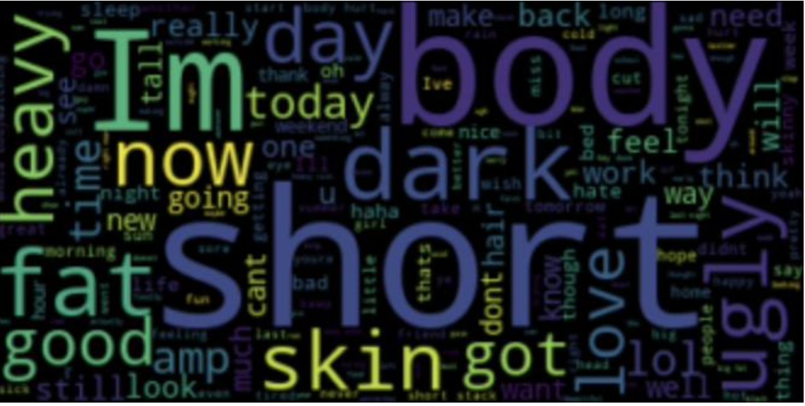
Exploratory Data Analysis Most Common Words
Entire Corpus
Filtered Dataset

Slide 4
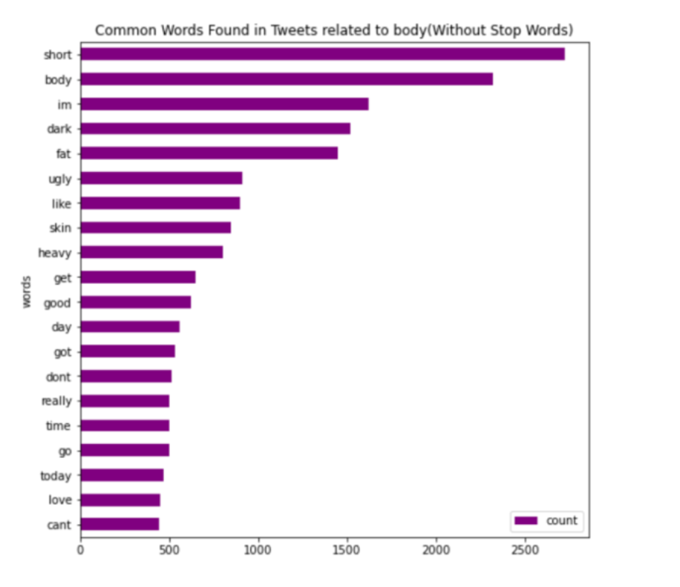
Exploratory Data Analysis Most Common Words

Slide 5
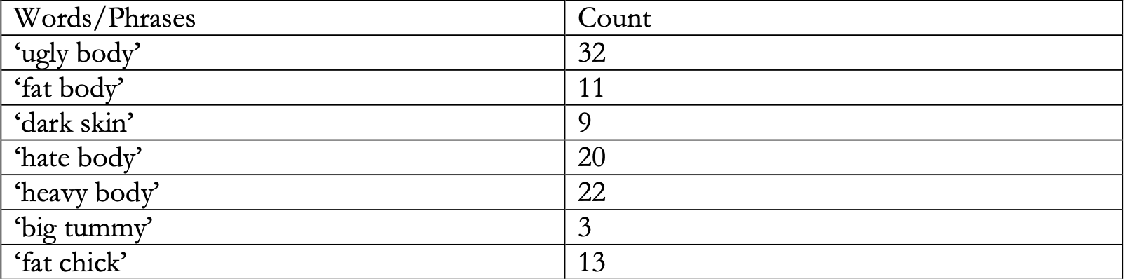
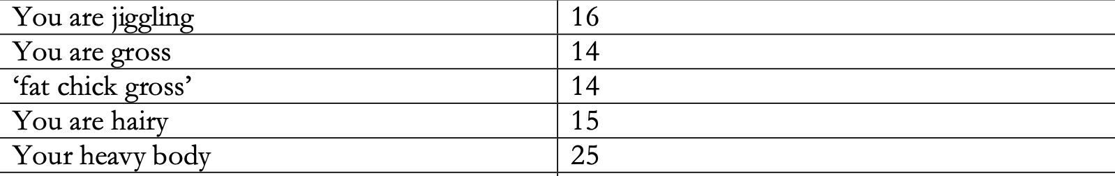
Count Vectorizer

Slide 6
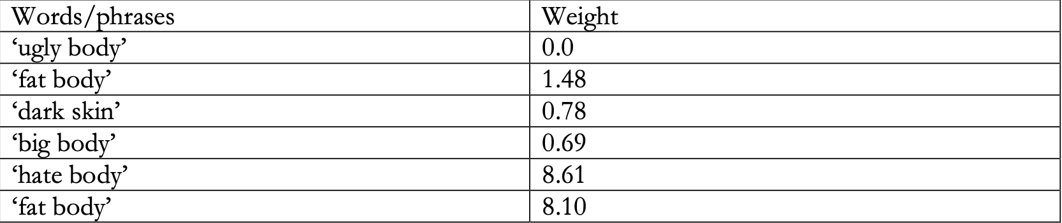
Tf-idf Vectorizer

Slide 7
LDA – Topic Modeling
‘Bag of Words’ Model
Tf-idf Model

Slide 8
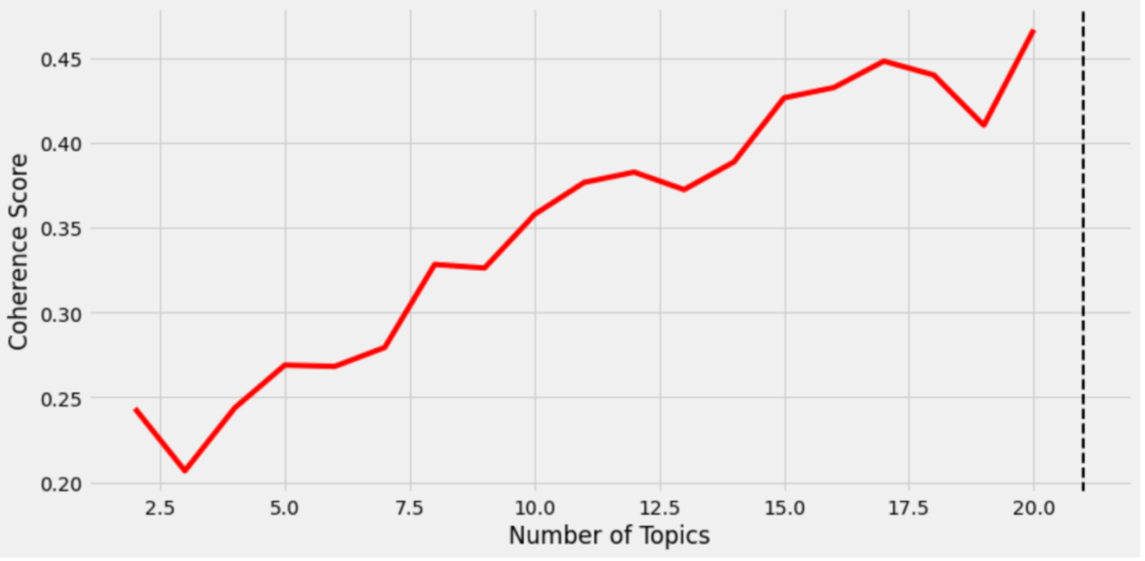
Coherence Score

Slide 9
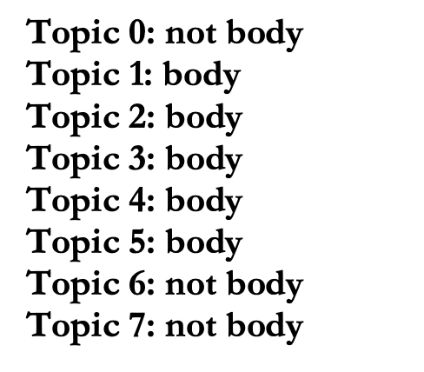
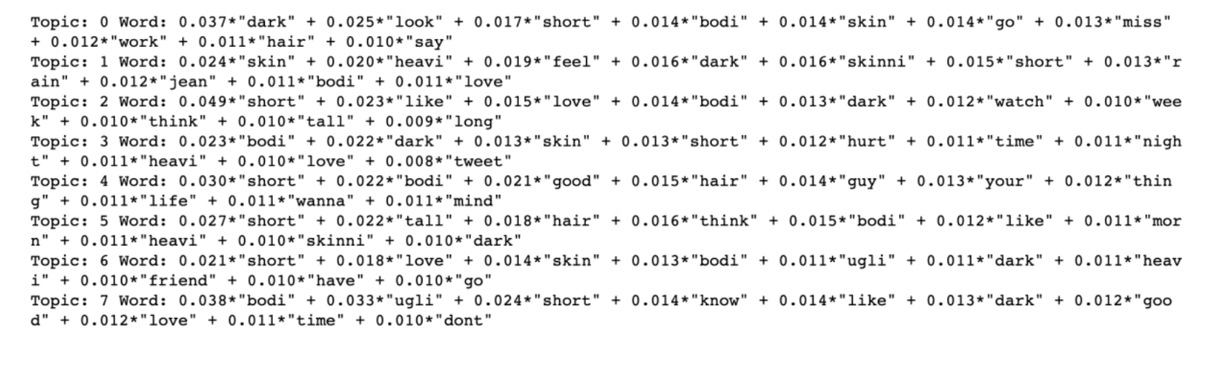
LDA Model with 8 topics

Slide 10
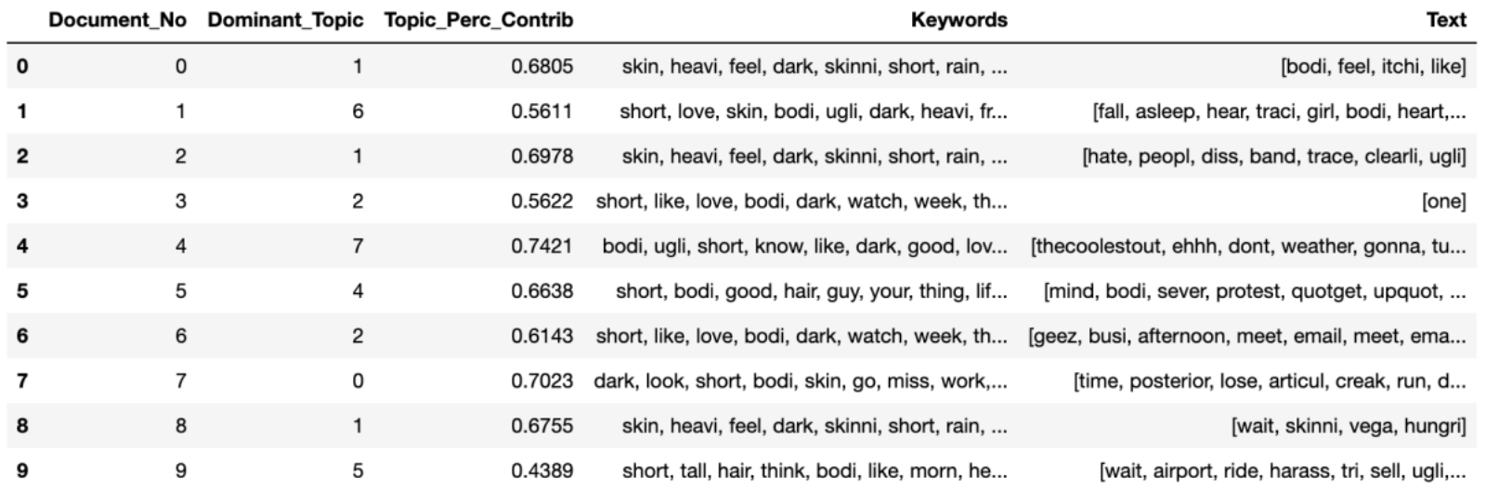





Dominant Topic

Slide 11
Body Shaming
‘Body Shaming’
Topic: Body
‘Not Body Shaming’
Topic: Not Body
Sentiment: Negative
Sentiment: Neutral or Positive

Slide 12
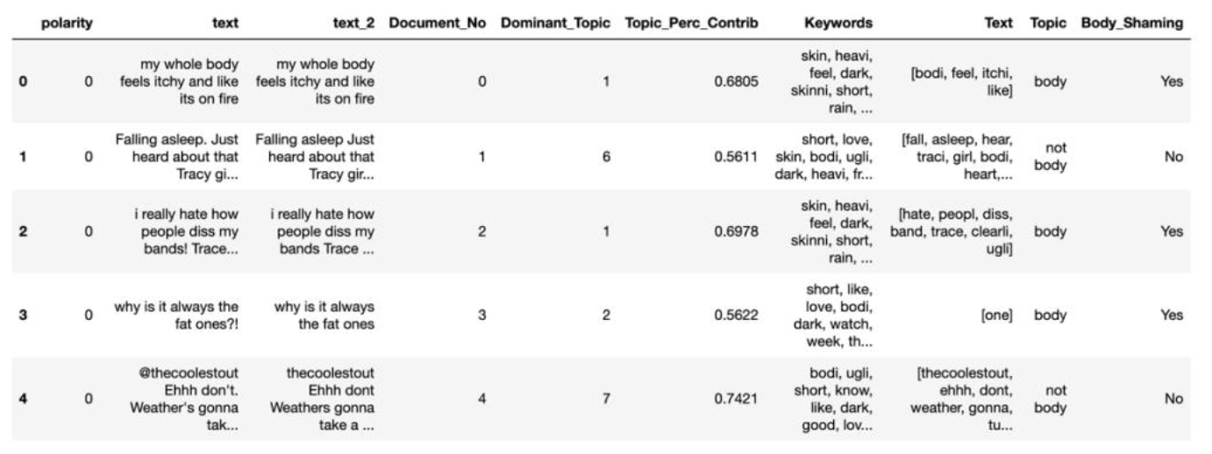

Body Shaming
Total 10782 tweets:
3830 are classified as ‘Body Shaming’ and 6952 are classified as ‘Bot Body Shaming’.

Slide 13
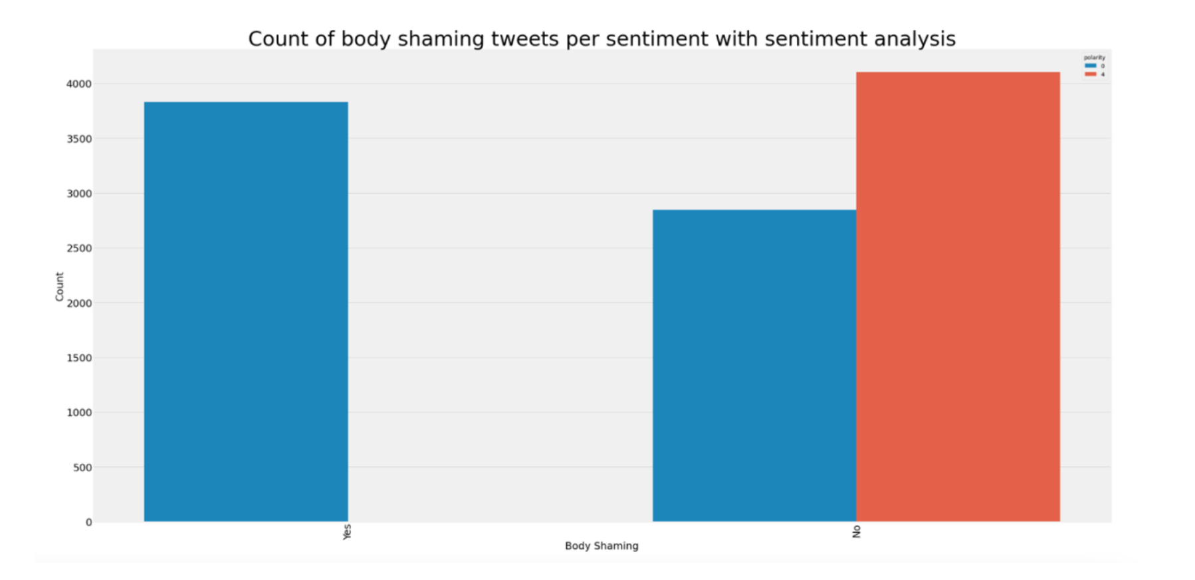
Body Shaming

Slide 14
Identified
Yes
No
“A show about fat people dancing Because everything is funnier when fat people do it”
“great not the only one here anymore ugly fat lady is here w ugly gay friendsoh wait they
left”
“kellyerin they are fat and old and nasty and flirt with meGAHHHH”
“feels like my hair is too dark to wear anything nice to work”
Yes
Verified
“I think imma lay in bed today my body is hurting”
“its really dark outside and its only PM its going to rain”
“viaHourt ahhh i see i see im in bed watching ugly betty lol”
“My friends short story is going to press Congrats Melody”
No

Slide 15
Limitations
Reproducibility
Hyperparameter Tuning
Sarcasm

